Slide 1
CAPSTONE PROJECT Portfolio Website
Presented By:
Student Name: Kandukuri. Pranavi
College Name: Vaageswari college of engineering
Department: CSE(AI & ML)

Slide 2
OUTLINE
Problem statement
System Development Apporach
Algorithm & Deployment
Result
Conclusion
Future Scope
References

Slide 3
Problem statement
Many students lack on online presence to showcase their skills.
Traditional resumes are not interactive or visually engaging.
Goal: Build a responsive portfolio website to overcome these limitations.

Slide 4
System Approach
Frontend Technologies:
HTML5 – Structure of the website.
CSS3 – Styling and responsive layouts.
Design Approach:
Clean and user-friendly interface.
Mobile-responsive design.
Modular separation of HTML, CSS.

Slide 5
Algorithm & Deployment
Frontend Design:
Layouts using HTML and CSS.
Interactive Features:
Each project has image, title, demo link.
Buttons like Home, About, Skills, Projects, Contact.
Click on Button -> user navigates to corresponding section/page.
Contact form allows users to send messages directly to email.
Interactive hover effects added on projects/buttons for better user experience.

Slide 6
Testing:
Cross-browser compatability ensured(Chrome, Firefox, Edge, 360 Extreme browser).
Web sites adjusts for mobile, tablet, and desktop views. (Adjust sizes).
Deployment:
Website deployed using GitHub, Netlify.
Publicly accessible through a live URL.
Ensures fast loading and proper rending on all devices.

Slide 7
Result
Code : index.html
<!DOCTYPE html>
<html lang="en">
<head>
<meta charset="UTF-8">
<meta http-equiv="X-UA-Compatible" content="IE=edge">
<meta name="viewport" content="width=device-width, initial-scale=1.0">
<title>Document</title>
<link rel="stylesheet" href="https://cdnjs.cloudflare.com/ajax/libs/font- awesome/7.0.0/css/all.min.css"
integrity="sha512-DxV+EoADOkOygM4IR9yXP8Sb2qwgid
EmeqAEmDKIOfPRQZOWbXCzLC6vjbZyy0vPisbH2SyW27
+ddLVCN+OMzQ=="crossorigin="anonymous"
referrerpolicy="no-referrer" />
<link rel="stylesheet" href="sty.css"/>

Slide 8
</head>
<body>
<header class="back" id="back">
<div class="container">
<div class="logo">Kandukuri.Pranavi</div>
<!-- Hamburger icon -->
<input type="checkbox" id="menu-toggle" />
<label for="menu-toggle" class="hamburger">&#9776;</label>
<!-- Navigation links -->
<nav>
<ul class="nav-links">
<li><a href="#hero">Home</a></li>
<li><a href="#About">About</a></li>
<li><a href="#Skills">Skills</a></li>
<li><a href="#Projects">Projects</a></li>
<li><a href="#contact">Contact</a></li>
</ul>
</nav>
</div>
</header>

Slide 9
<section class="hero" id="hero">
<div class="profile">
<img src="women.jpg" alt="profile">
</div>
<div class="text-content">
<h2>Hello, I'm</h2>
<h1>kandukuri pranavi</h1>
<h3>And I'm a <span class="highlight">Front-end developer</span></h3>
<p>
Hi I'm Kandukuri pranavi, a passionate front-end developer
specializing in traslating design ideas into responsive webpages <br>
using HTML, CSS, JavaScript.
</p>
<div class="icons">
<a href="mailto:pranavikandukuri3@gmail.com" target="_blank"><img src="email.png" alt="E-mail"></a>
<a href="https://www.linkedin.com/in/pranavi-kandukuri-5654a8326" target="_blank"><img src="linkedin.png" alt="LinkedIn"></a>
<a href="https://github.com/kandukuripranavi" target="_blank"><img src="github.webp" alt="GitHub"></a>

Slide 10
</div>
</div>
</section>
<div class="next1">
<a href="#About">NEXT</a>
</div>
<section class="hero2" id="About">
<div class="sec2"><u>About</u></div>
<div class="About">
<div class="sec2-1">
<img src="women.jpg" alt="profile">
</div>
<div class="sec2-2">
<p>
I'm Kandukuri.pranavi, a passionate Computer Science and Machine Learning Student Currently in my final year at Vaageswari college of engineering. I love turnig ideas into reality through code. My journey in tech has led me to explore python, web development (HTML, CSS, JavaScript, Node.js), and Strong intret in AI, Machine Learning, and deep Learning. I have developed different type of Projects, such as Machine Learning based live vehicle tracking and counting system and EyeDeep-Net, a deep Learning-powered multiclass retinal disease diagnosis solution ihave also build an interactive web pages and portfolio websites.<br>

Slide 11
I'm passionate about solving real world problems through technology and strive to create solutions that are technically robust, user-friendly, and visually appealing with a strong commitment to continuos Learning, i enjoy taking on challenges that enhance both my technically skills and creative thinking.
</p>
</div>
</div>
<div class="next2">
<a href="#Skills">NEXT</a>
</div>
</section>
<section class="hero3" id="Skills">
<div class="part3"><u>Skills</u></div>
<div class="skills">
<div class="box1">

Slide 12
<i class="fa-solid fa-code"></i><br>
<h3>Front-end Development</h3>
<p>HTML, CSS, JavaScript</p>
</div>
<div class="box1">
<i class="fa-solid fa-server"></i><br>
<h3>Back-end Development</h3>
<p>Node.js</p>
</div>
</div>
<div class="skills2">
<div class="box2">
<span style="font-size: 28px; font-weight:bolder; color: #ff007f; padding-top: 12px; padding-bottom: 20px;"> { } </span>
<h3>Programming Languages</h3>
<p>HTML, CSS, JavaScript, Python</p>
</div>
<div class="box2">
<i class="fa-solid fa-gear"></i><br>
<h3>Tools & Platforms</h3>
<p>VS code, Git</p>

Slide 13
</div>
</div>
<div class="next3">
<a href="#Projects">NEXT</a>
</div>
</section>
<section class="hero4" id="Projects">
<div class="part4-1">
<u>Projects</u>
</div>
<div class="part4-2">
<div class="pbox1">
<img src="prj1.PNG" alt="Clothing Store">
<div class="pbox1-1">
<span>Clothing Store(E-prj)</span>
<div class="btns">
<a href="https://github.com/kandukuripranavi" target="_blank"><button>GitHub</button></a>

Slide 14
<a href="https://frabjous-trifle-bada89.netlify.app/" target="_blank"><button>Demo</button></a>
</div>
</div>
</div>
<div class="pbox1">
<img src="Eye.PNG" alt="Clothing Store">
<div class="pbox1-1">
<span>EyeDeep-Net</span>
<div class="btns">
<a href="https://github.com/kandukuripranavi" target="_blank"><button>GitHub</button></a>
</div>
</div>
</div>
<div class="pbox1">

Slide 15
<img src="UIimg.webp" alt="Clothing Store">
<div class="pbox1-1">
<span>UI PAGES</span>
<div class="btns">
<a href="https://drive.google.com/file/d/1u2E0X1PQhh-P-poNcPJ-XvnR6NSJDkno/view?usp=drive_link"
target="_blank"><button>View</button></a>
</div>
</div>
</div>
</div>
<div class="next4">
<a href="#contact">NEXT</a>
</div>

Slide 16
</div>
</section>
<section class="hero5" id="contact">
<div class="part5-1"><u>Contact</u></div>
<div class="part5-2">
<form action="mailto:pranavikandukuri3@gmail.com">
<div class="Cbox">
<div class="name"><u>Contact Me</u></div>
<div class="det">
<input type="text" placeholder="Name" required><br>
<input type="text" placeholder="E-mail" required><br>
<textarea name="message" cols="30" rows="10" required></textarea>
<div class="btns">
<button>Submit</button>
</div>
</div>
</div>
</form>

Slide 17
<div class="next5">
<a href="#back">HOME</a>
<a href="#About">About</a>
<a href="#Skills">Skillls</a>
<a href="#Projects">Projects</a>
</div>
</section>
<footer>
<p>@2025 kandukuri pranavi. All rights are reserved.</p>
</footer>
</body>
</html>

Slide 18
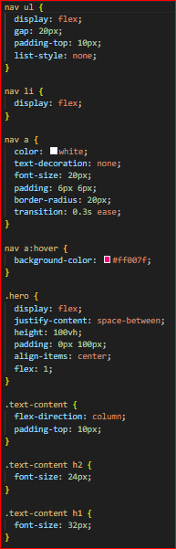
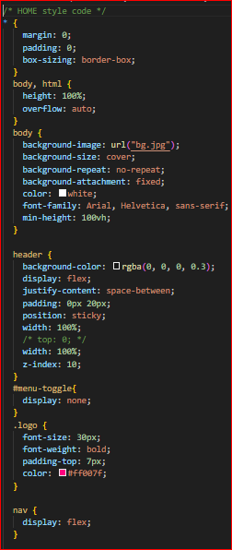
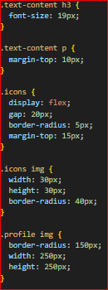
Sty.css

Slide 19
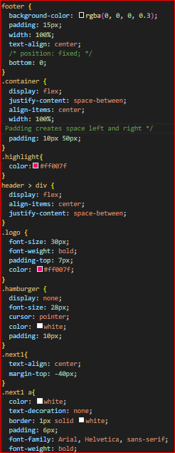
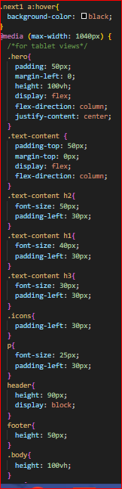
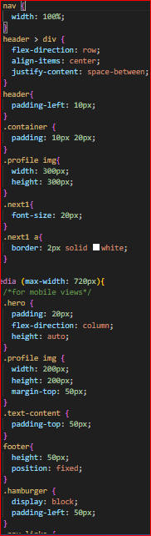

Slide 20
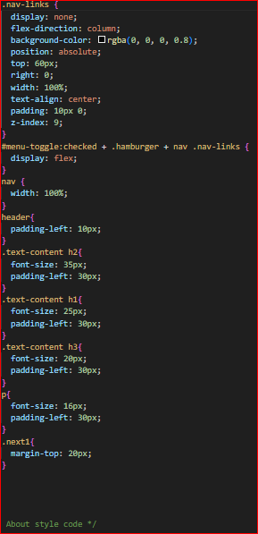
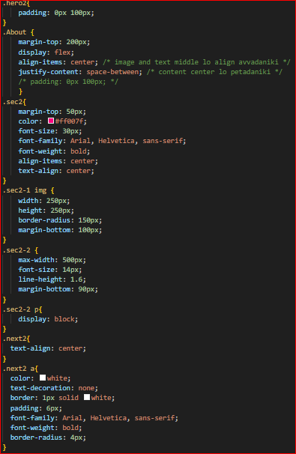

Slide 21
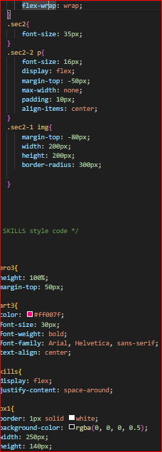
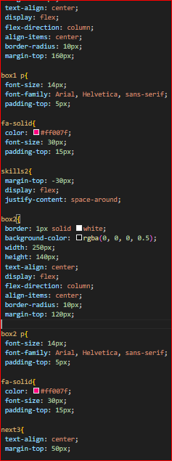
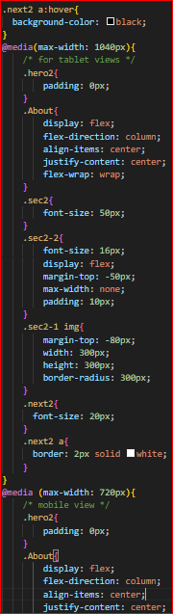

Slide 22
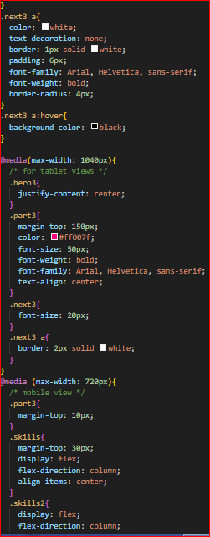
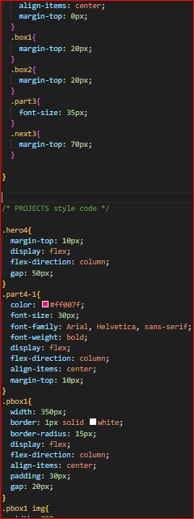
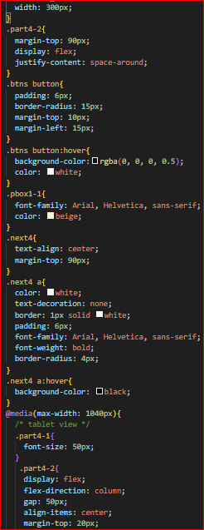

Slide 23
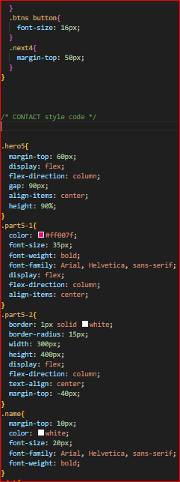
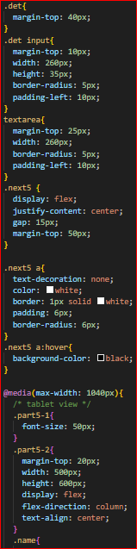
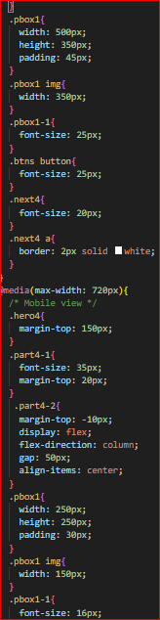
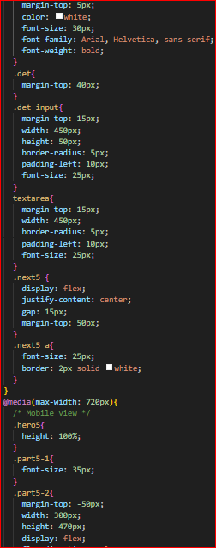

Slide 24
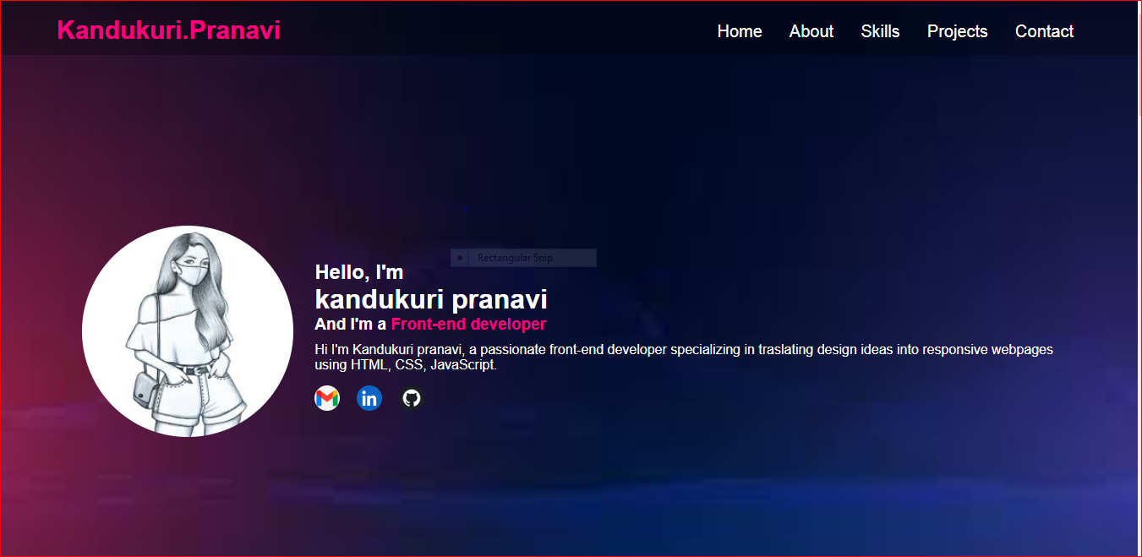
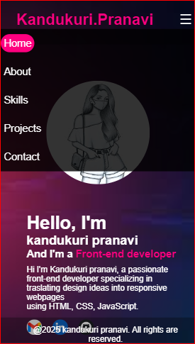
Output
Main Page
Mobile View

Slide 25
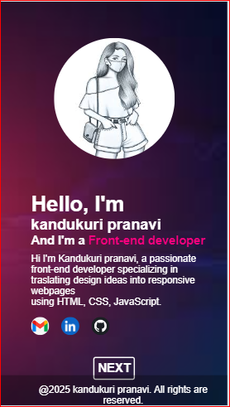
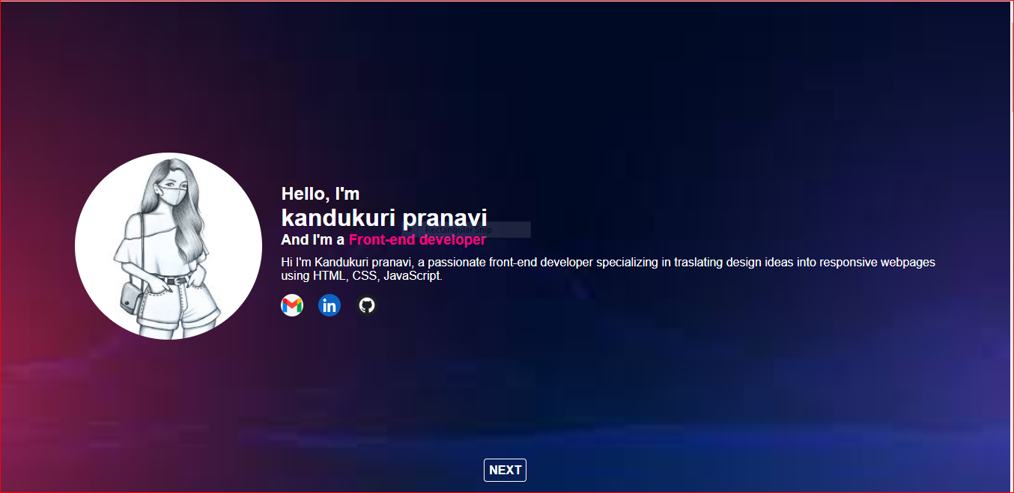
Home Page
Mobile view

Slide 26
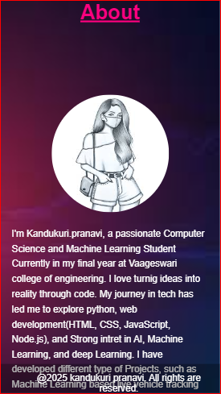
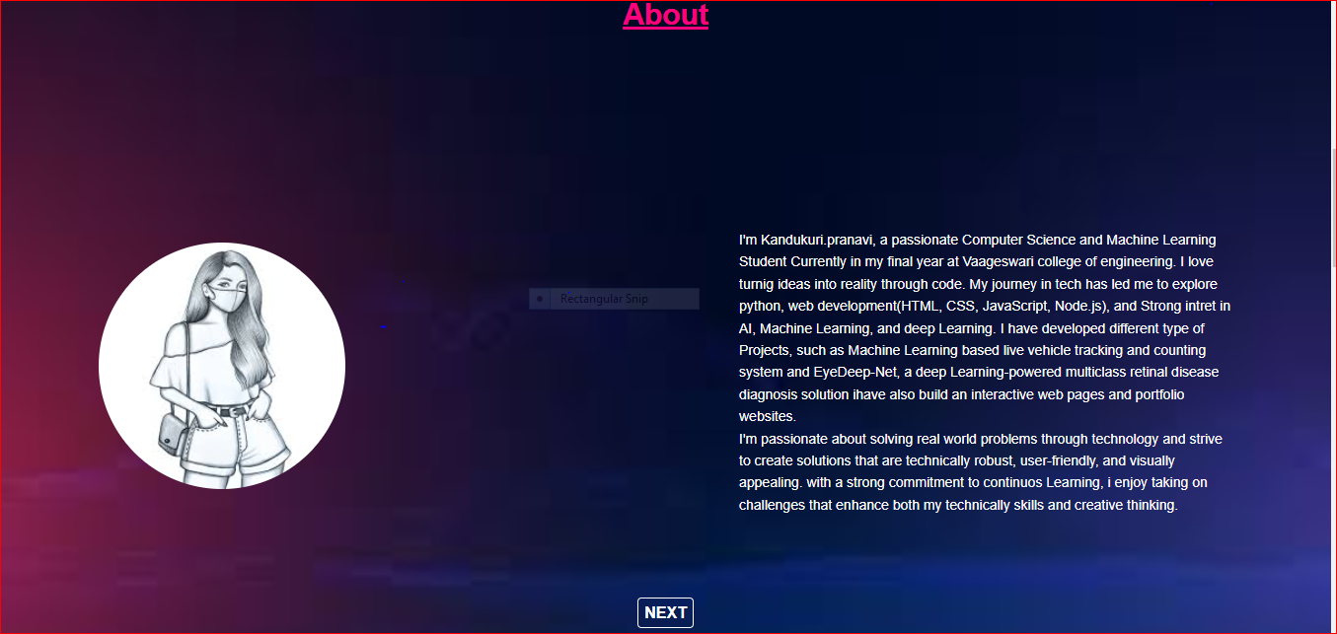
About Page
Mobile view

Slide 27
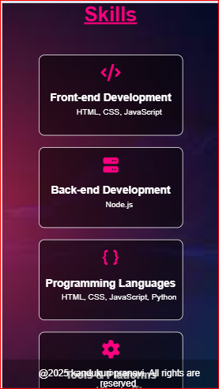
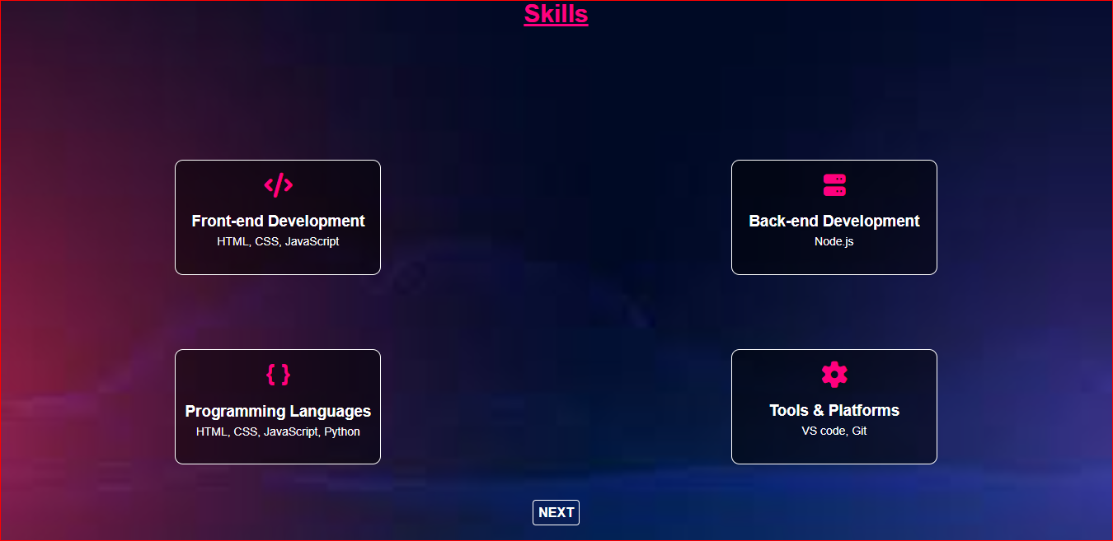
Skills Page
Mobile view

Slide 28
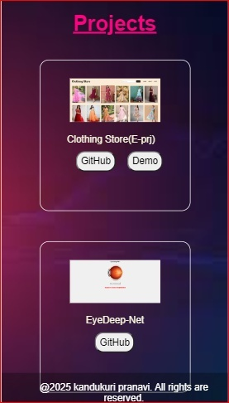
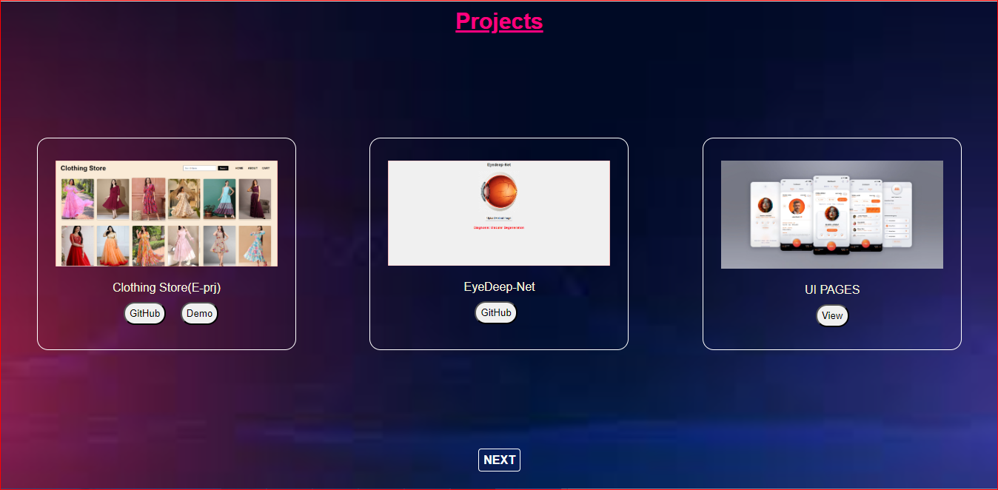
Projects Page
Mobile view

Slide 29
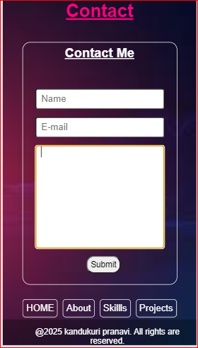
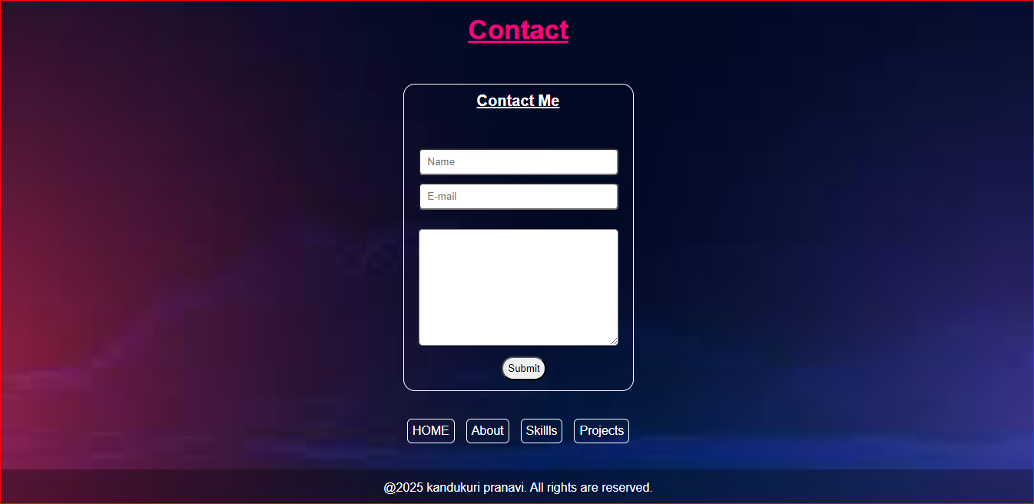
Contact Page
Mobile view
GitHub: https://github.com/kandukuripranavi/Portfolio
Deployment: https://kandukuripranavi.github.io/Portfolio/

Slide 30
Conclusion
This Portfolio demonstrates my expertise in web development and design through practical projects.
It highlight my technical skills, creativity, and problem-solving abilities, reflecting my commitment to delivering high-quality, innovative solutions and my continuous growth as a developer.

Slide 31
References
Tools & technologies: HTML5, CSS3
Tutorials: Edunet foundation (IBM)
Images/Icons: Google.

